Slide 1
5.1 The internet and the world wide web
Uniform resource locator (URL)

Slide 2
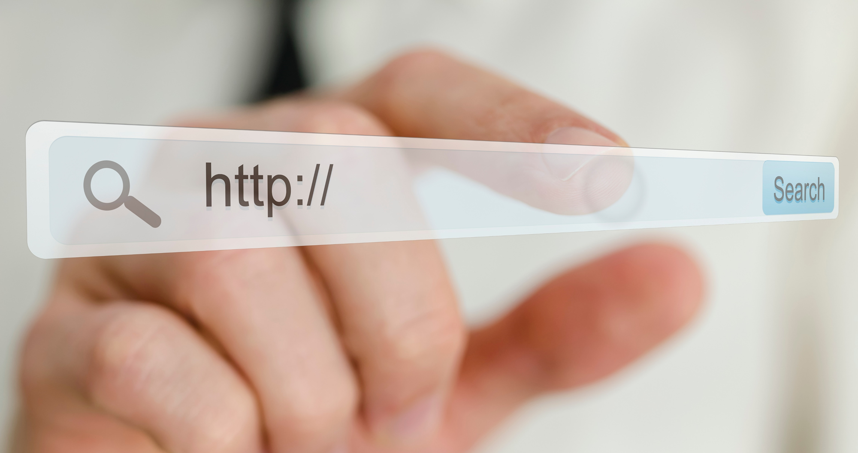
What is a URL?
A uniform resource locator (URL) is a unique, text-based address that relates to a web page.
craigndave.org/resources
These web pages are accessed by typing their URL into a web browser such as:
Google Chrome™
Microsoft® Edge
Apple® Safari

Slide 3
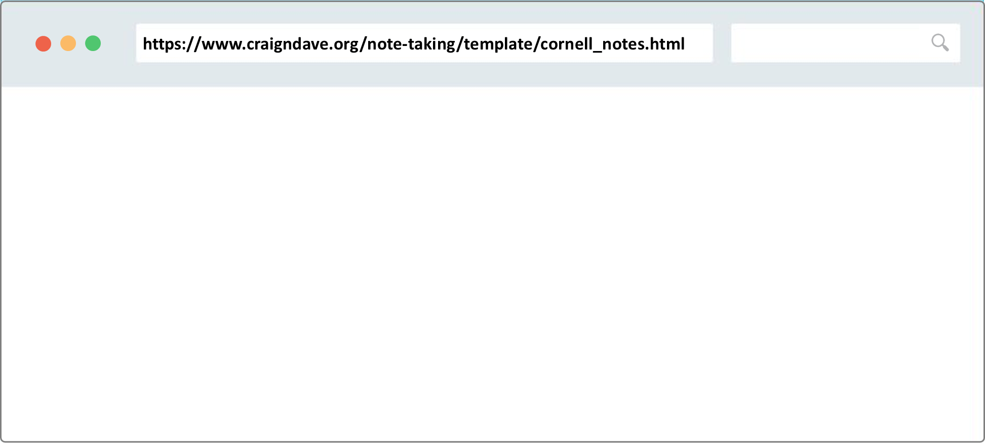
The parts of a URL

Slide 4
The parts of a URL
Protocol
method
https://www.craigndave.org/note-taking/template/cornell_notes.html

Slide 5
The parts of a URL
Protocol
method
Host
https://www.craigndave.org/note-taking/template/cornell_notes.html

Slide 6
The parts of a URL
Protocol
method
Host
Domain name
https://www.craigndave.org/note-taking/template/cornell_notes.html
Website domain name
Fully qualified domain name

Slide 7
The parts of a URL
Protocol
method
Host
Domain name
Location
https://www.craigndave.org/note-taking/template/cornell_notes.html
Website domain name
Fully qualified domain name

Slide 8
The parts of a URL
Protocol
method
Host
Domain name
Location
Resource (web page/file)
https://www.craigndave.org/note-taking/template/cornell_notes.html
Website domain name
Fully qualified domain name
Uniform resource locator (URL)

Slide 9

Uniform resource locator (URL)
A uniform resource locator (URL) is a text-based address for a web page. It can contain:
The protocol – e.g., http, https
The host – e.g., www
The site’s domain name – e.g., craigndave.org
The web page/location – e.g., note-taking/template
The resource/file name – e.g., cornell_notes.html
Example of a complete URL: https://www.craigndave.org/note-taking/template/cornell_notes.html

Slide 10


